Slide 1

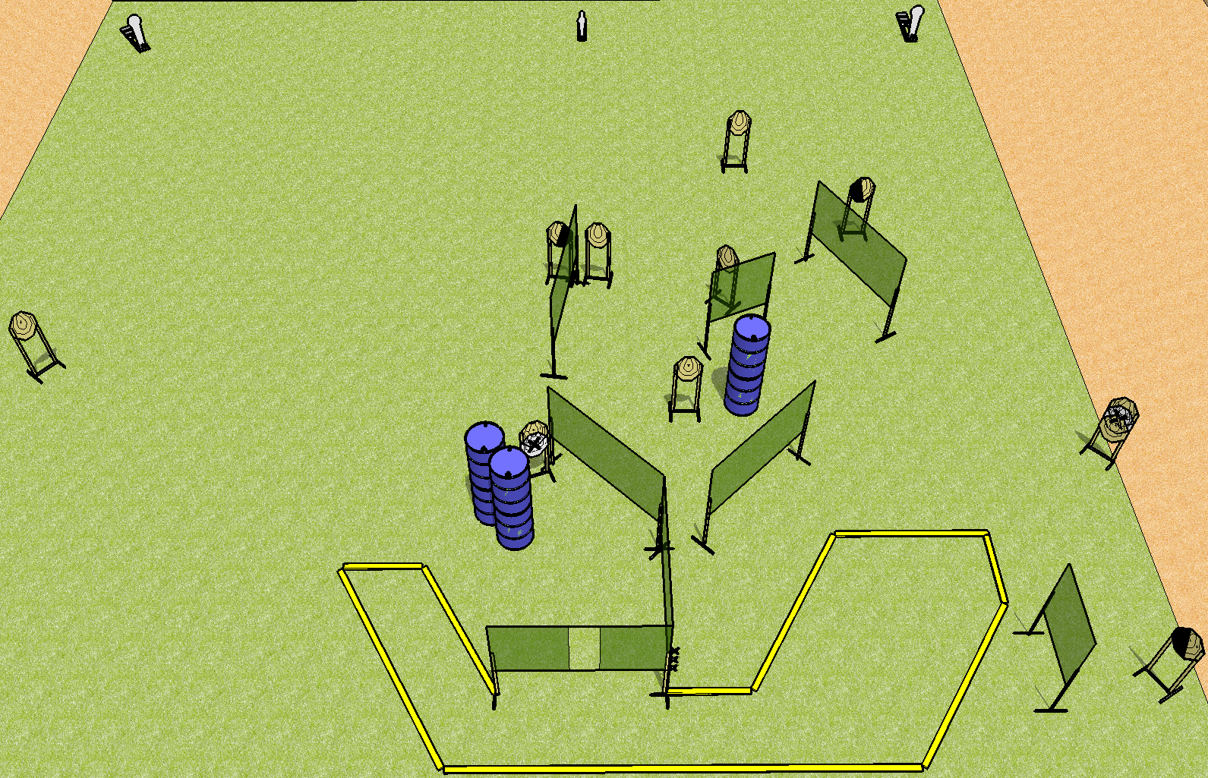
 | Dothan Practical Shooters – USPSA Match Riptide Run Course Designer : Drew Coleman Bay: A2
Round Count 25 rounds 11 IPSC 2 colt poppers, 1 mini popper
Equipment List 15 wall feet 2 left diag, 1 right diag 10 targets (8 + 2NS)

Slide 2
Riptide Run
Written Stage Briefing
Scoring: Comstock Rounds: 25 rounds
Targets: 11 IPSC, 3 steel
Handgun start position: hands touching marks, handgun is unloaded and holstered.
PCC start position: muzzle touching mark, stock on belt. Unloaded carbine is held with both hands.
Stage Procedure: on the audible start signal, engage targets as they become available from within the shooting area.

